Slide 1

Real-Time Hybrid Wildlife Tracking on Edge Networks
Mini Project Presentation Advanced Digital Signal Processing Lab NIT Rourkela

Slide 2
Project Team & Supervision
• Supervisor: Dr. Upendra Kumar Sahoo
• Teaching Assistants: Kannuru Srinadh, Yerram Deekshith Kumar, Debapriya Das Gupta
• Lab: ADSP Lab, NIT Rourkela
• Course: Advanced Digital Signal Processing
Project Team:
225EC6005
225EC6013
225EC6021
225EC8004
225EC8013

Slide 3
Problem Statement
• Wildlife monitoring essential for ecological research and conservation
• Traditional methods (GPS collars, radio tags) are invasive and expensive
• Camera-based tracking offers non-intrusive monitoring solution
• Challenges: Remote locations, limited bandwidth, battery constraints
• Need: Real-time tracking on edge devices with minimal resources

Slide 4
Project Objectives
• Develop a video-based animal tracking system
• Detect animals using deep learning (YOLOv8n)
• Track individuals across consecutive frames
• Maintain identity during temporary occlusions
• Handle multiple animals without ID switches
• Optimize for edge network deployment

Slide 5
System Architecture

Slide 6
System Block Diagram
Video Input
Frame Extraction
YOLOv8n Detection
Feature Extraction
Track Management
Hungarian Matching
Kalman Filter Prediction
Visualization & Export
Tracked Output

Slide 7
Hybrid Tracking Approach
• Combines two complementary strategies:
• Motion Prediction: Kalman Filter for state estimation
• Appearance Matching: HSV color histogram features
• Hungarian Algorithm for optimal track-detection assignment
• Benefits: Robust to occlusions and unpredictable movements

Slide 8
Detection Module: YOLOv8n
• YOLOv8 Nano - lightweight for edge deployment
• Input resolution: 640x640 pixels
• Training: Animal Track Dataset
• Classes: Deer (cls 0), Horse (cls 1), Pig (cls 2)
• Achieved mAP50: 97.95% on test set
• Real-time inference on GPU-enabled edge devices

Slide 9
Motion Prediction: Kalman Filter
• State vector: [x, y, vx, vy] - center position and velocity
• Predict step: Estimate next position using motion model
• Update step: Refine estimate using actual detection
• State Transition Matrix: Constant velocity model
• Handles temporary occlusions through prediction
• Provides smooth trajectory estimation

Slide 10
Kalman Filter Mathematics
• State Transition: x_k = F * x_{k-1} + w
• Observation: z_k = H * x_k + v
• Prediction: x_k|k-1 = F * x_{k-1}
• Update: x_k = x_k|k-1 + K * (z_k - H * x_k|k-1)
• Kalman Gain: K = P * H^T * (H*P*H^T + R)^{-1}
• P, Q, R: Covariance matrices for state, process, measurement

Slide 11
Appearance Matching: Color Histograms
• Extract HSV color histogram from detection bounding box
• Histogram bins: 16 x 16 x 16 (Hue, Saturation, Value)
• Normalized feature vector (4096 dimensions)
• Cosine distance for similarity comparison
• Computationally efficient for edge devices
• Robust to minor pose and illumination variations

Slide 12
Data Association: Hungarian Algorithm
• Build cost matrix: Tracks x Detections
• Cost = 0.4 * motion_dist + 0.6 * appearance_dist
• Motion: Euclidean distance (predicted vs detected center)
• Appearance: Cosine distance between histograms
• Hungarian algorithm: Optimal one-to-one assignment
• Threshold: Reject matches with cost > 0.8

Slide 13
Dataset & Implementation

Slide 14
AnimalTrack Dataset
• Training: 14 video sequences (deer, horse, pig)
• Testing: 5 video sequences
• Total: 6430 training frames, 1442 validation frames
• MOT-style annotations: frame, id, x, y, w, h, conf, cls, vis
• Videos from wildlife camera traps in natural settings

Slide 15
Implementation Details
• Framework: Python 3.10, PyTorch, OpenCV
• Detection: Ultralytics YOLOv8n (yolov8n.pt)
• Tracking: FilterPy Kalman Filter + SciPy linear_sum_assignment
• Platform: Kaggle GPU (NVIDIA P100)
• Output: Annotated videos with trajectories + metrics CSV
• Processing: Real-time capable on modern edge hardware

Slide 16
Results & Evaluation

Slide 17
Quantitative Results Summary
Metric
Value
Description
MOTA
71.48%
Multi-Object Tracking Accuracy
Precision
86.21%
Correctly identified objects
Recall
85.93%
Detected objects from ground truth
mAP50
97.95%
Detection accuracy at IoU 0.5
Train Sequences
14
deer, horse, pig videos
Test Sequences
5
Evaluation videos

Slide 18
Tracking Performance Analysis
• Mean MOTA: 71.48% - Strong multi-object tracking accuracy
• Precision: 86.21% - Low false positive rate
• Recall: 85.93% - High true positive detection rate
• Consistent identity maintenance across frames
• Smooth trajectories with Kalman filtering
• Total ID switches = 1037, Average ID Switches per frames = 0.7%

Slide 19
Challenges & Solutions
• Challenge: Animals hidden behind objects or other animals
- Solution: Kalman prediction maintains track during occlusion
• Challenge: Similar-looking animals causing ID switches
- Solution: Appearance features + Hungarian matching
• Challenge: Computational constraints on edge devices
- Solution: Lightweight YOLOv8n + efficient color histograms

Slide 20
Edge Network Optimization
• Model: YOLOv8 Nano (smallest variant, ~3.2M params)
• Features: Color histograms vs. heavy deep embeddings
• Processing: Frame-by-frame without batching
• Memory: Track pruning with max_missed threshold (15 frames)
• Communication: Only essential track data transmitted
• Trade-off: Optimized for latency over marginal accuracy gains

Slide 21
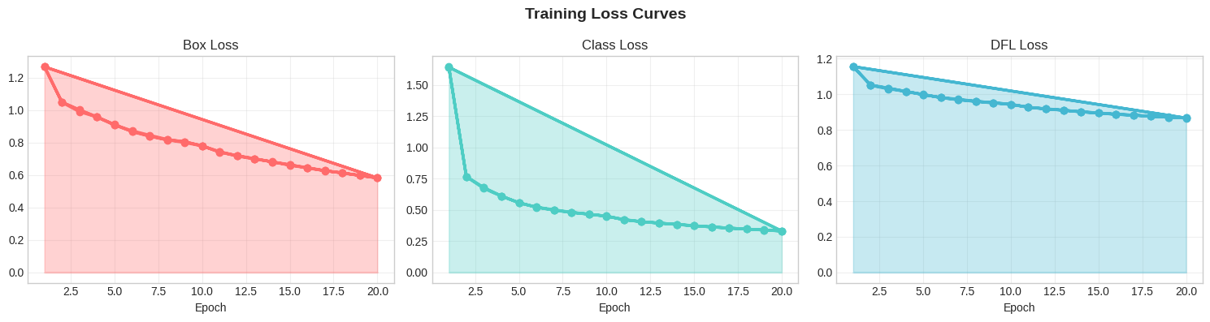
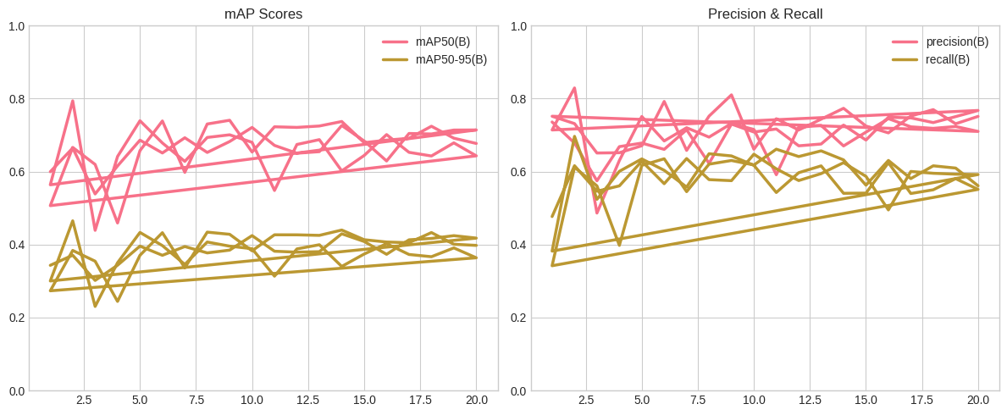
Training Results

Slide 22
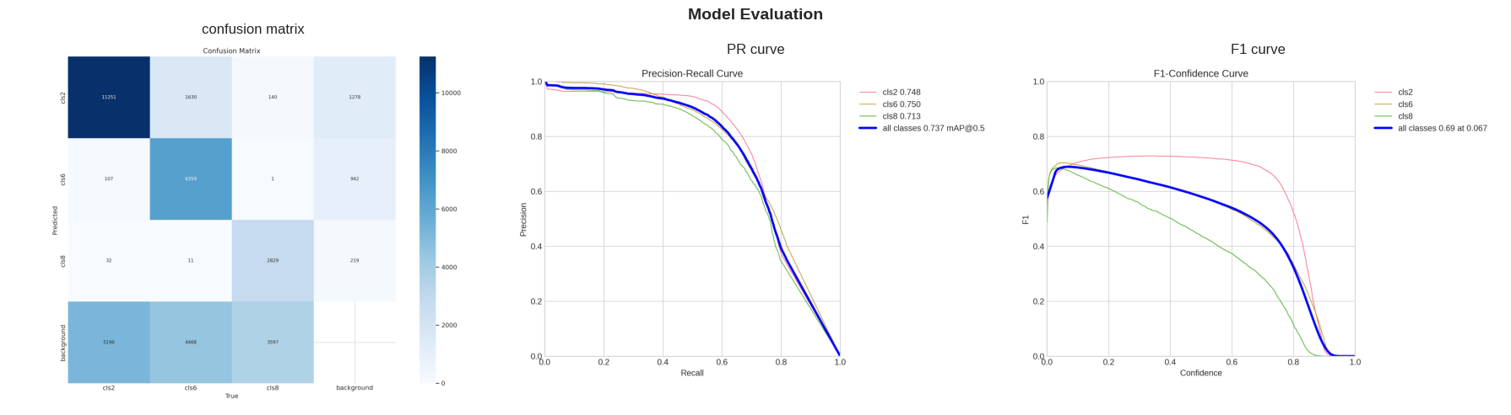
Model Evaluation

Slide 23
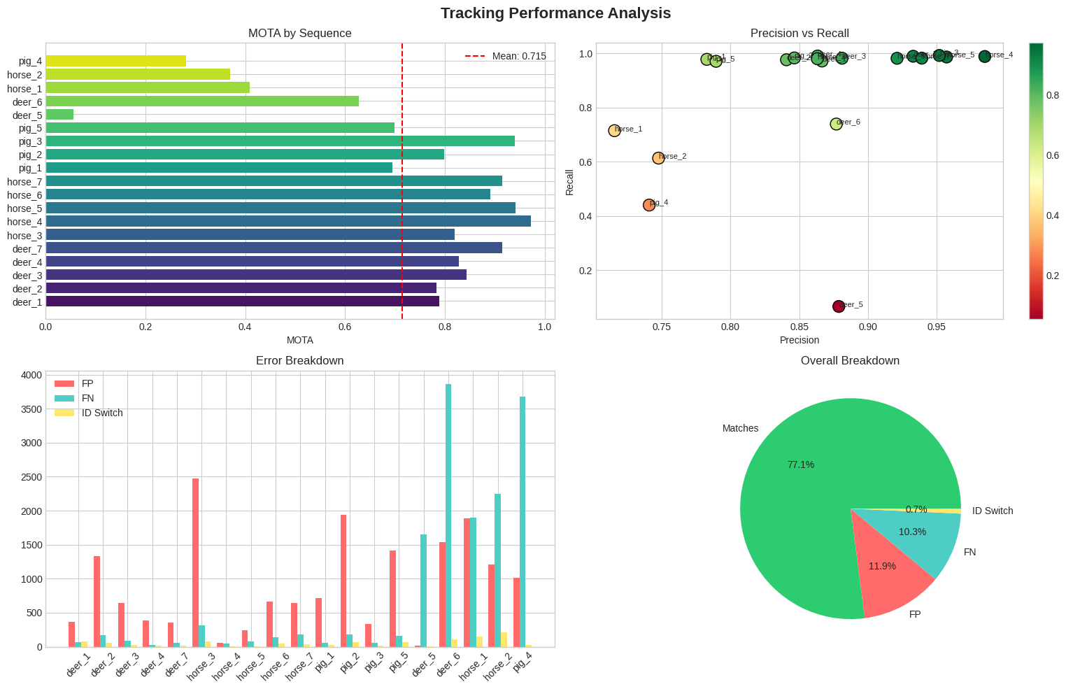
Tracking Performance Analysis

Slide 24
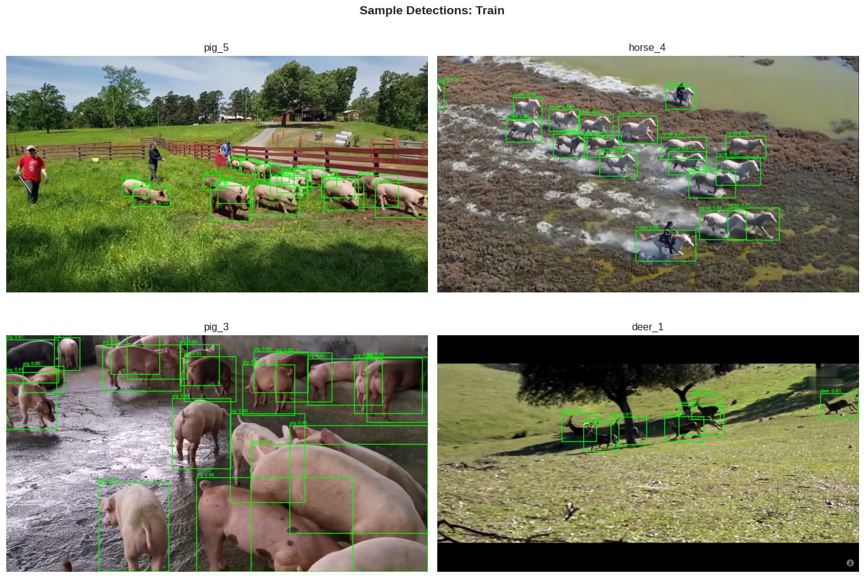
Sample Detection on Train

Slide 25
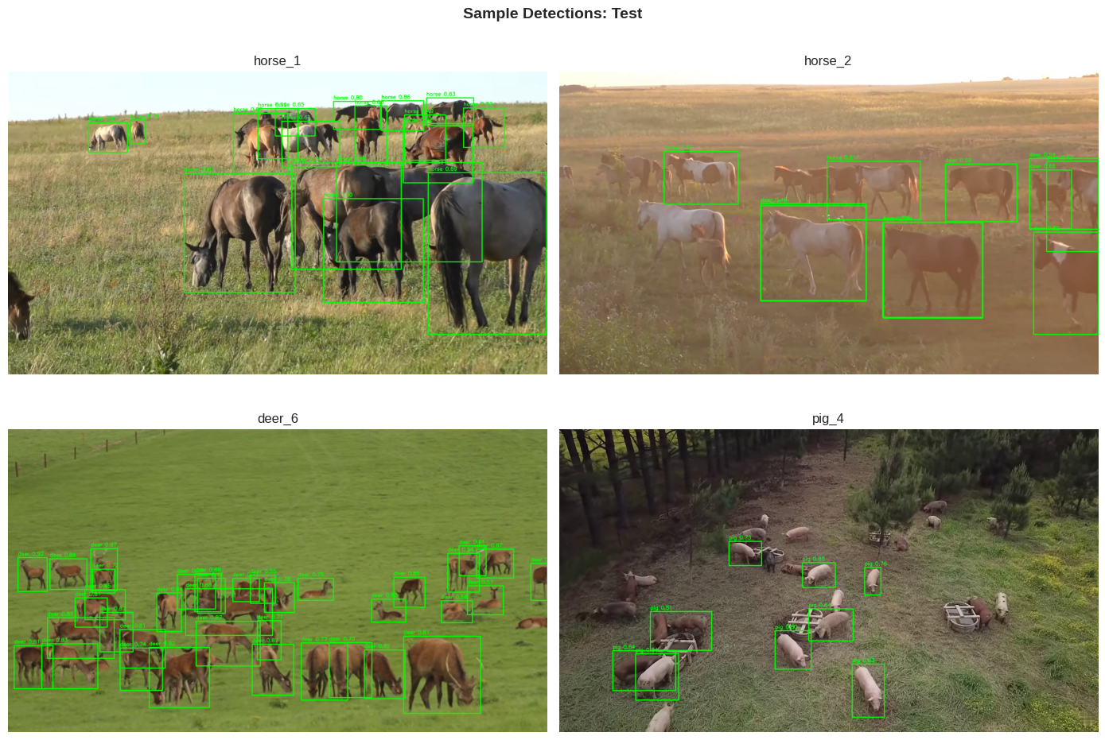
Sample Detection on Test

Slide 26
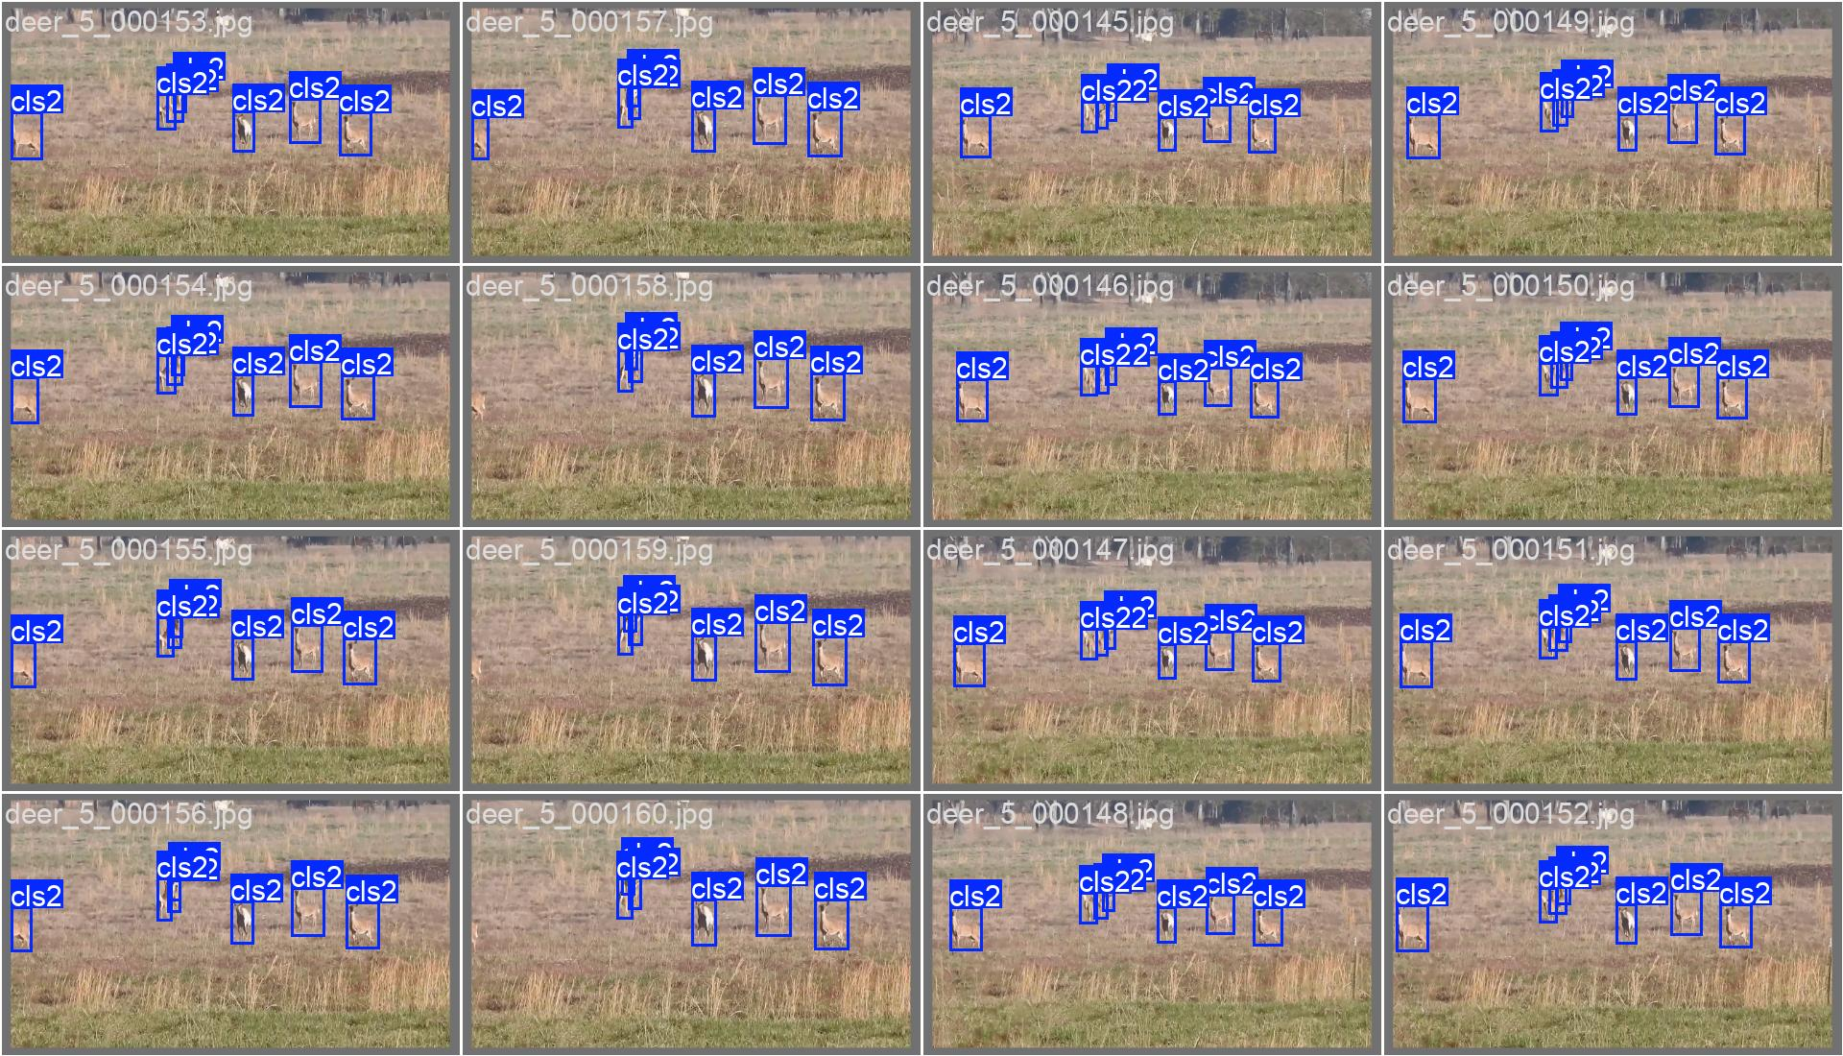
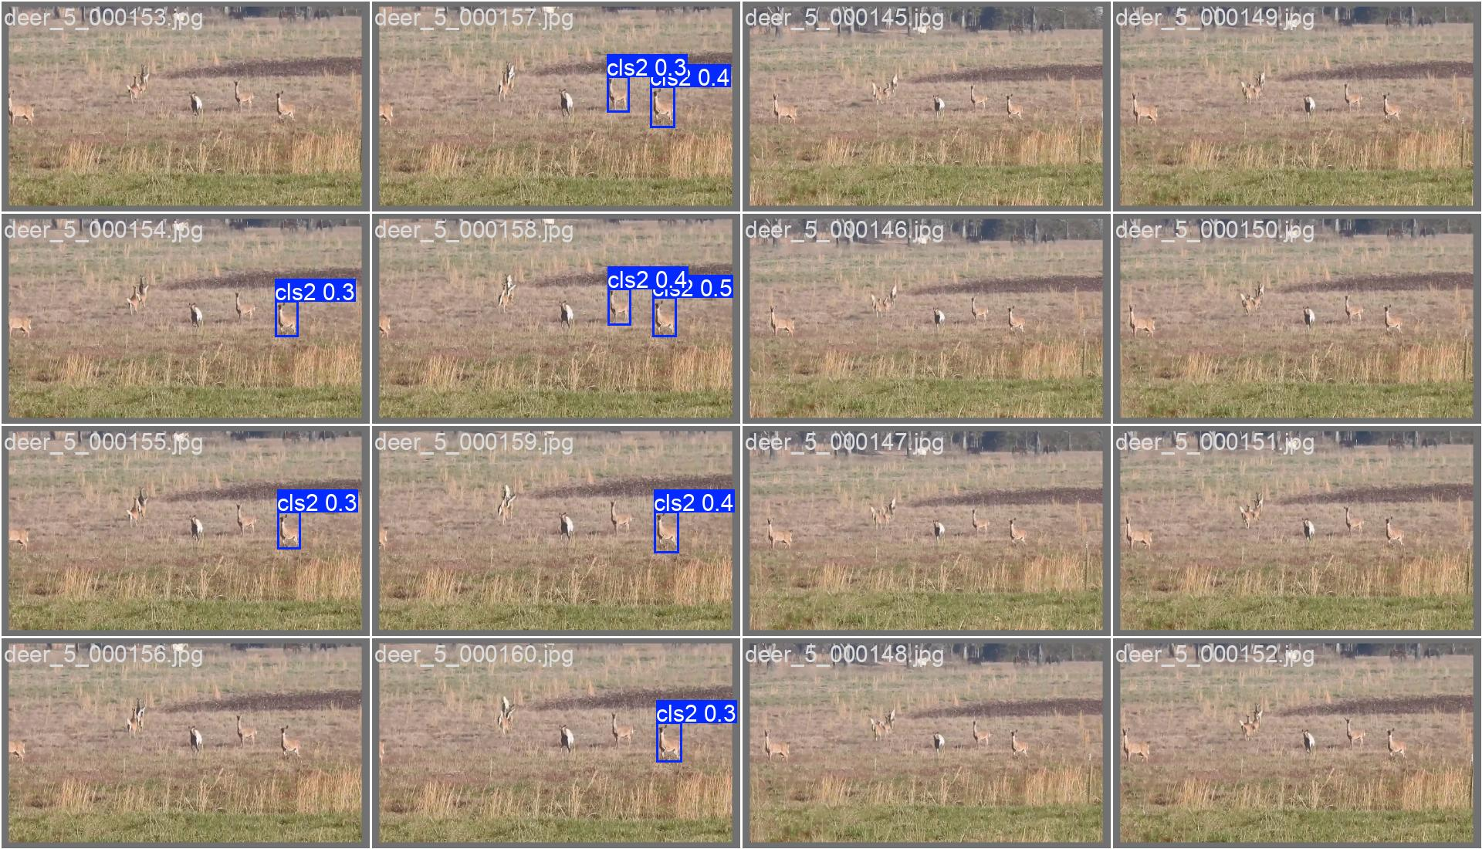
Ground Truth Predicted
Limitations

Slide 27
Conclusion
• Developed hybrid wildlife tracking system
• Combined YOLOv8n + Kalman Filter + Hungarian matching
• Achieved MOTA: 71.48%, Precision: 84.96%, Recall: 87.39%
• Handles occlusions through prediction-based recovery
• Optimized for edge deployment scenarios
• Provides foundation for wildlife conservation applications

Slide 28
References
• Ultralytics YOLOv8 - https://github.com/ultralytics/ultralytics
• FilterPy Kalman Filter - https://filterpy.readthedocs.io
• SORT Algorithm - Bewley et al., 2016
• Hungarian Algorithm - scipy.optimize.linear_sum_assignment
• MOT Metrics - Bernardin & Stiefelhagen (CLEAR MOT)
• OpenCV - Computer Vision Library

Slide 29
Thank You
Questions?

